Slide 1
6MMCS002W Digital Marketing, Social Media and Web Analytics
Week 10 – Key Performance indicators
Dr Vassiliki Bouki
boukiv@wmin.ac.uk

Slide 2
Web Analytics and KPIs
“Most people are using web analytics as a benchmark: how did we do yesterday, and how are we doing today?
Smart people are actually analyzing to optimize their website.
The advanced people are using Web data to optimize all of their marketing.”
Jim Sterne, founding director and chairman of the Web Analytics Association
Everything we have discussed so far is useless if it is not translate to actions.

Slide 3
Web Analytics and KPIs
Tools (like Google Analytics) generate reports.
Reporting is NOT analysis.
Reports → provide data
Analysis → provides insights
You cannot expect to get massive insights from any analytics tool simply by implementing this tool.
Implementing the analytics tool is the start – not the end.
How could we make the next step and to which direction this should be?

Slide 4
Web Analytics and KPIs
In order to move on, we should be aware about the business strategy / business goals – stakeholders are involved.
The following steps are essential:
1. Map your stakeholders.
2. Brainstorm with them.
3. Set the (expected) key results of the organisation (OKRs).
Encourage your stakeholders to give measurable answers to your objectives question or suggest some yourself
4. Distil and refine your OKRs.
Examples

Slide 5
Web Analytics and KPIs
In order to achieve in the ‘organisational key results’ (OKRs) you need to identify smaller targets that can be measured and they provide information about the performance of the company.
Key Performance Indicators (KPIs) are used to measure performance.
What is a KPI?
KPI: a tool that companies use to understand how well they are doing.
They are used by managers & external investors to understand how well a company is doing.
KPIs are sometimes referred to as Key Success Indicators (KSI) or as Balanced Score Cards (BSC)
To track KPIs, most companies use a Balanced Scorecard.

Slide 6
Process – structure
In order to define a KPI you must provide:
Brief description e.g. reduce the number of single-page visits (previously known as ‘bounce rate’, now part of the ‘engagement rate’)
Exact change e.g. the number of single-page visits from 45% should be 20% or it must be reduced by 50%
Time e.g. within 6 months
Changes we’ll do e.g. change design
Monitoring period e.g. every 3 weeks

Slide 7
Web Analytics and KPIs
The balanced scorecard is a strategic planning and management system that is widely applicable to organizations regardless of size or type of business. The system, extensively used in business and industry, government, and non-profit organizations worldwide, provides a method of aligning business activities to the vision and strategy of the organization, improving internal and external communications, and monitoring organization performance against strategic goals.
It was originated by Robert Kaplan and David Norton of Harvard University in about 1990 (the roots of the balanced scorecard are deep, and include the pioneering work of General Electric on performance measurement reporting in the 1950’s and the work of French process engineers in the early part of the 20th century in France).
Balanced scorecard; Performance measures – KPIs:
https://www.youtube.com/watch?v=M_IlOlywryw

Slide 8
Web Analytics and KPIs
Basic categories of KPIs / Basic ways to think about KPIs
 | Raw Data | Progress (usually project oriented) | Changes (or directional measure )
Source of data
Do data exist or should we create them?
E.g. Is there a report in GA or should we create a goal?
Daily? Weekly? Monthly? Quarterly? Yearly?
Frequency
If you have a yearly goal, think of a metrics to measure your progress between months (e.g. Customer satisfaction).
Target
What is the target we try to hit;
Graphical representations of the data.
Examples
No of users more than 100
80% of a project has been completed
10% increase

Slide 9
Web Analytics and KPIs
What are the most common KPIs?
KPIs are about ‘what matters’....
‘What matters’ is different in each company and in different times.
Financial indicators: income growth
Engagement (employee or users)
All KPIs must be based on company’s strategy

Slide 10
Web Analytics and KPIs
How to decide your KPIs?
When considering your KPIs, bear in mind the following:
Try to use monetary values where possible; everybody understands monetary values (£ $ Euros etc)
If monetary value are not used, use a ratio, percentage, or average rather than the raw number. This allows data to be presented in context.
A KPI needs to be temporal, that is, time bound. This highlights change and its speed.
A KPI drives business-critical actions. Many things are measurable, but that does not make them key to your organization’s success.
Use KPIs to put your data into context.

Slide 11
Web Analytics and KPIs
How to put a KPI into context?
For example:
Saying “We had 750 visitors this week” provides a piece of data, but it is not a KPI because it has no context.
In order to put it into context you should provide further information to show if this is good or bad.
Saying “We had 750 visitors this week. Last week we had 500 visitors. Our visitor numbers are up 50% this week” is context.
It is not always percentages that provide context; there are cases where raw numbers have greater impact. It depends on the case and how the KPI has been define.
Example 1: If your KPI is to monitor server’s performance, information such as “our website lost 15 orders yesterday because our e-commerce server was down for 35 minutes” provides context (tells us that our server does not work well) and have great impact in future decisions.
Example 2: If our KPI is to monitor design, information such as “we lost $10,000 in potential revenue last week because our booking system does not work for visitors who use Firefox” provides context.

Slide 12
Web Analytics and KPIs
Some ideas:
http://www.winningkpi.com
Best practices with KPIs:
https://www.youtube.com/watch?v=91SKwBX419k
In the following slide we’ll see some examples of KPIs directly related to websites and Google Analytics.

Slide 13
GA & KPIs (from ‘Advanced Web Metrics with Google Analytics’)
Stakeholder OKR
To see more traffic from search engines
To sell more products
To see visitors engaging with our website more
To improve the customer experience
Suggested KPIs
Percentage of visits from search engines
Percentage of conversions from search engine visitors
Percentage of visits that add to shopping cart
Ratio of visits that complete the shopping cart over the number that started
Percentage of visits in which shopping cart is abandoned at position X in the process
Percentage of visits that leave a comment, click the ‘like’ button (Facebook Like, Twitter Follow, Google +1, etc.) or download a brochure
Percentage of visits that complete a Contact Us form or click a mailto link
Average time on site per visit
Average page depth per visit
Percentage of single-page visits (previously known as: bounce rate; now part of engagement rate )
Percentage of internal site searches that produce zero results
Percentage of visits that result in a support ticket being submitted

Slide 14
GA & KPIs
How to use GA in relation to KPIs?
Google Analytics is the tool to collect data.
It is easy to be lost with all the data that can be collected.
Make sure you are familiar with what GA (or any other web analytics tool you use) offers.
Know your KPIs
Identify the reports that could be used to meet your KPIs.
It is very likely that in order to monitor your KPIs you should define segments; goals; intelligent events.

Slide 15
GA & KPIs
Example 1:
Stakeholder OKR:
Improve user’s engagement
KPIs:
Reduce single-page visits by 50%
Increase the number of users who sign up for our newsletter.
Increase by 10% the time users stay in our site.
Change / directional measure
Raw Data
Change / directional measure

Slide 16
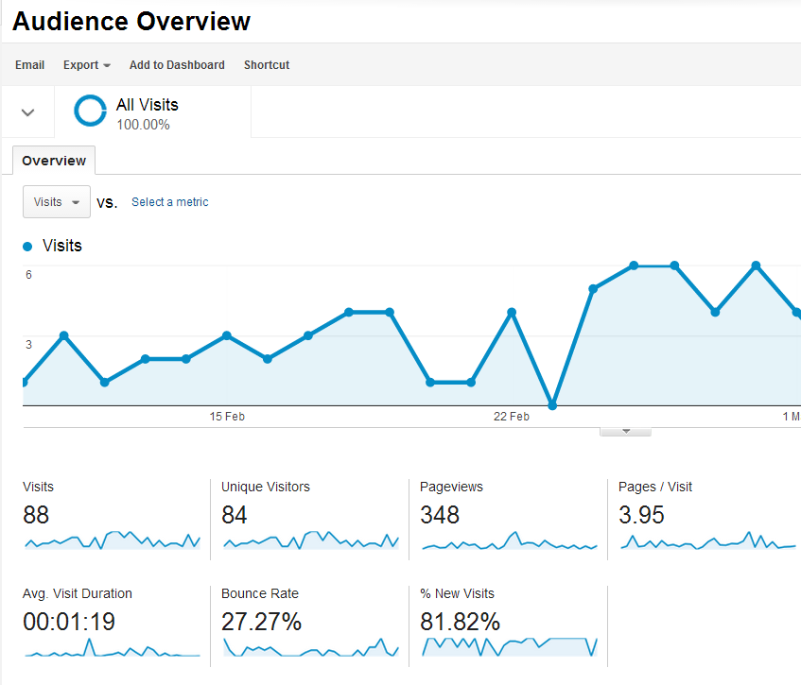
GA & KPIs
KPI (from example 1): Reduce single-page visits (increase engagement rate) by 50%
This is a ‘Change / directional measure’ KPI;
We should define by when we want this KPI to be achieved (e.g. within 3 months)
‘Single-page visits’ are related to the engagement rate
Trying to identify the reasons for single-page visits you might want to connect them with dimensions such as ‘Channels’ (from Acquisition).
E.g. a high % of single page visits (’bounce rate’ in the report on the right) in ‘organic search’ might mean that you should reconsider your ‘optimization’ .

Slide 17
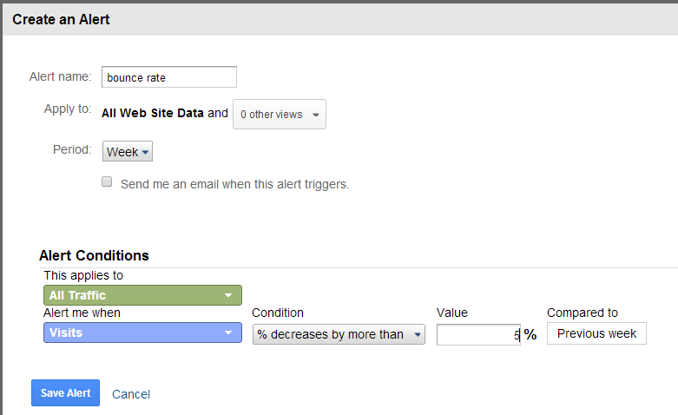
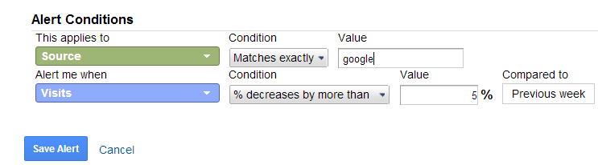
GA & KPIs
Next step is to create an intelligent event (alert) that shows you weekly changes in the single-page visits / engagement rate.
You can combine several conditions in order to get a better picture.

Slide 18
GA & KPIs
Example 2:
Stakeholder OKR:
To sell more products
KPIs:
Monitor shopping basket and reduce the % of abandon items by 50%.
Monitor check out process and identify possible obstacles.
Increase income 10,000£ per month.
Change / directional measure
Progress
Raw Data

Slide 19
GA & KPIs
KPI (from example 2): Monitor check out process and identify possible obstacles.
Create a GOAL for confirmation page with Funnels.
Possible funnels:
Level 1: Add items to basket
Level 2: Complete delivery details
Level 3: Complete payment details
Level 4: Confirmation page
all Funnels must be set to ‘required’.
Monitor what is the percentage of users who abandon the process at level 2 and level 3.
Create alerts.

Slide 20
Web Analytics and KPIs
Tip: As part of your role as a web analyst, you might also want to include KPIs that are not part of your Google Analytics reports—for example, search engine rankings, notes of any offline campaigns or PR, website updates, new product launches, user feedback, news and events that impact your business, server uptime, and response speed. All of these can help explain what you see and therefore add value to your data.
(from ‘Advanced Web Metrics with Google Analytics’)

Slide 21
Web Analytics and KPIs
How to present your KPIs.
In your report it is important to show what the target is and what your findings are.
.xls files are often used to present KPIs.
After KPIs:
Make decisions; take actions
What could prevent people from making decisions?
Confidence on data
Different interpretations → experiment
http://www.youtube.com/watch?v=CH6V0wfT6PA

Slide 22
Next Week
This week we discussed KPIs and we saw examples how to use Google Analytics in order to monitor KPIs.
Next week, we will discuss “email marketing”: how to use email for marketing purposes; how to organise an email campaign and how to write an email that aims to create leads as well as loyal customers.

